Slide 1

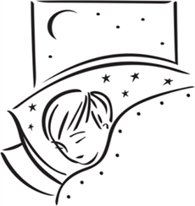
Summer School:
«Neuro-Sleep as a Complex System»
SLEEP EEG PATTERN IN CHILDHOOD:
FROM NEWBORN TO ADOLESCENT
Olga Berdina, PhD
Irina Madaeva, PhD, ScD,
Lyubov Rychkova, PhD, ScD, RAS Corresponding Member
SC FH HRP
Saratov, 10-12 July 2023
Notes:
Dear colleagues, I am very (so) glad to take part in this wonderful summer school and let me introduce my presentation about changing of sleep EEG pattern across childhood.

Slide 2
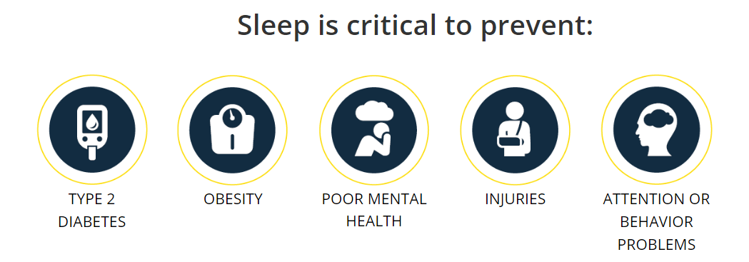

Good Sleep – Healthy Child
Every child of any age
have to get enough sleep!
https://www.cdc.gov/chronicdisease/resources/infographic/children-sleep.htm.
Notes:
It’s well known, that sleep is as important for good health as diet and exercise. It is particularly important for children and adolescents as they need to grow and develop. Quality sleep is necessary to ensure the plasticity of the brain, growth and maturation, development and improvement of mental abilities, to prevent some chronic diseases. Than the child younger, the more time he sleep. However, we must remember that every child of any age have to get enough sleep!

Slide 3
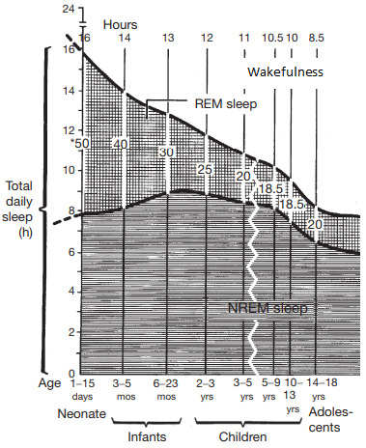
Ontogeny of Sleep in Childhood
Three primary behavioral states:
Wakefulness - an activated electroencephalogram (EEG) - alpha waves, high muscle tone, gross body movements;
Non-REM sleep (quiet sleep in newborns) - EEG tetha, sigma, delta waves (slow waves), decreased muscle
tone, behavioral quiescence;
REM sleep (active sleep in newborns) - an activated EEG- alpha waves, absence of muscle tone, rapid eyes movements (REMs).
Active and quiet sleep at
birth each occupy 8 h of the day.
As active sleep declines with age, the amount of
time spent waking increases.
Blumberg MS. Ontogeny of Sleep / Encyclopedia of Sleep, 2013
Notes:
In the human life are three primary behavioral states characterized by certain physiological parameters: wakefulness, non-REM sleep (quiet sleep in newborns) and REM sleep (active sleep in newborns). In neonates, sleep time dominates over wakefulness, active and quiet sleep each occupy 8 h of the day. As active sleep decreases with age, the amount of time spent awake increases. It is believed that a high percentage of active sleep in early childhood is important for autostimulation, as well as for the functional brain maturation, the development and improvement of cognitive abilities.

Slide 4
Synaptogenesis, apoptosis, and myelination are critical in the maturation of functional neuronal circuit from neonatality to adolescence. These processes determine the physiological neuroplasticity, which is reflected in the formation and development of various neurophysiological patterns in different behavioral states.
An electroencephalogram (EEG) is a test that measures the electrical activity in the brain and lets see any neurophysiological phenomena as during wakefulness as in the sleep. It is one of the safest, most accessible and adequate methods for assessing the functional brain state, its maturation and the formation of bioelectrical activity across the childhood. The sleep EEG objectively quantifies the need for recovery of neuronal networks.
Notes:
It’s should be noted, that synaptogenesis, apoptosis, and myelination are critical in the maturation of functional neuronal circuit from neonatality to adolescence. These processes determine the physiological neuroplasticity, which is reflected in the formation and development of various neurophysiological patterns in different behavioral states. An electroencephalogram lets see any neurophysiological phenomena as during wakefulness as in the sleep, and asesses the functional brain state, its maturation and the formation of bioelectrical activity across the childhood.

Slide 5
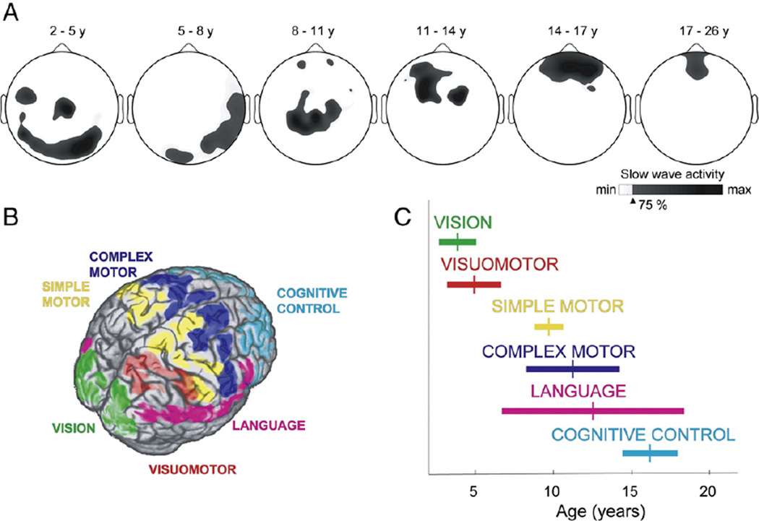
Slow Wave Activity = Brain Maturation
Sleep slow wave activity (SWA, 1–4.5 Hz) reaches a maximum during the middle of childhood and exponentially declines during adolescence;
Development of SWA parallels major changes in cortical maturation (e.g., the formation and subsequent elimination of synapses);
The cortical region displaying maximal SWA shifts from back to front. This postero-anterior maturation of SWA topography parallels the structural maturation of the cortex (e.g. cortical gray matter thickness) and fits to the development of functions.
Kurth S et al. Neuroimage. 2012
Notes:
It is known that slow wave activity during deep sleep reflects cortical maturation and reaches a maximum during the middle of childhood and exponentially declines during adolescence. There is postero-anterior trajectory of SWA maturation across childhood.

Slide 6
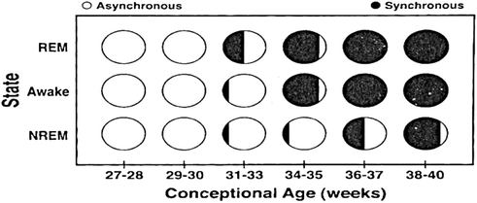
Sleep EEG in the Neonatal Period
(the first 4 weeks of life)
The changes in the neonatal EEG are associated with brain maturation
and depend on conceptional age (CA).
An EEG of a healthy term baby is characterized by amplitude symmetry and synchrony of the bursts. Normally, some transient EEG patterns are recorded in newborns.
https://neupsykey.com/neonatal-eeg-and-neonatal-seizures/
Notes:
It’s interestingly, that each period of childhood have specific features and phenomena of sleep EEG which associated with brain maturation. It should be said that in neonates sleep EEG pattern are depended on conceptional age. Today we tell about EEG features in full term babies, whose conceptional age is more 37 weeks. So, an EEGs of a healthy term babies are characterized by amplitude symmetry and synchrony of the bursts. Normally, some transient EEG patterns are recorded in newborns.

Slide 7
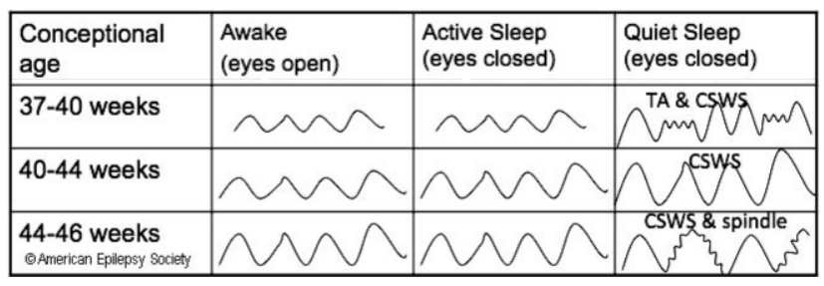
Specific Sleep EEG Patterns in Newborns
Continuous activity (CSWS) – a trace with a steady amplitude, low- and high-amplitude tetha and delta waves;
Tracé alternant (TA) – specific EEG pattern during quiet sleep characterized by alternating periods of high-voltage burst intervals and low-amplitude interburst interval);
Delta brushes (DBs) - CSWS with superimposed fast oscillations (8-25 Hz) – important indicators of the brain maturation
&
DBs
https://neupsykey.com/neonatal-eeg-and-neonatal-seizures/; Whitehead K. et al, 2017
Notes:
There are continuous activity, tracé alternant , “delta brushes” (DBs). Between 37 and 40 weeks CA, the EEG is continuous and similar during awake and active sleep states. During quiet sleep, there is tracé alternant with some periods of continuous slow wave sleep. EEG is completely synchronous and reactive to internal or external stimuli. Between CA 40 and 44 weeks, the EEG is continuous during the awake, active sleep and continuous slow wave sleep portion of quiet sleep. EEG is reactive in all states and synchronous. Between CA 44 and 46 weeks, the EEG is continuous in all states.

Slide 8
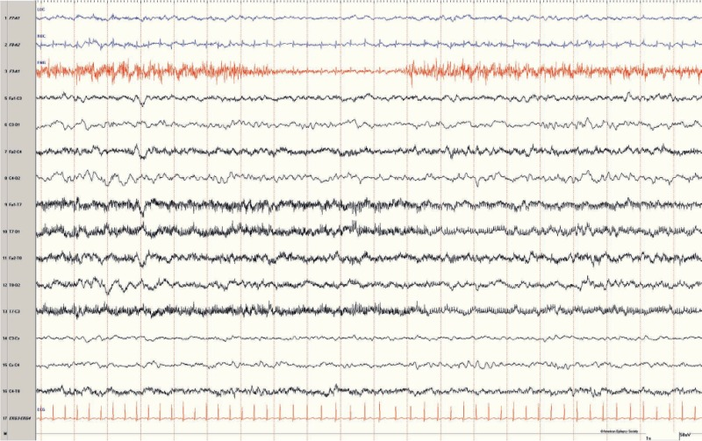
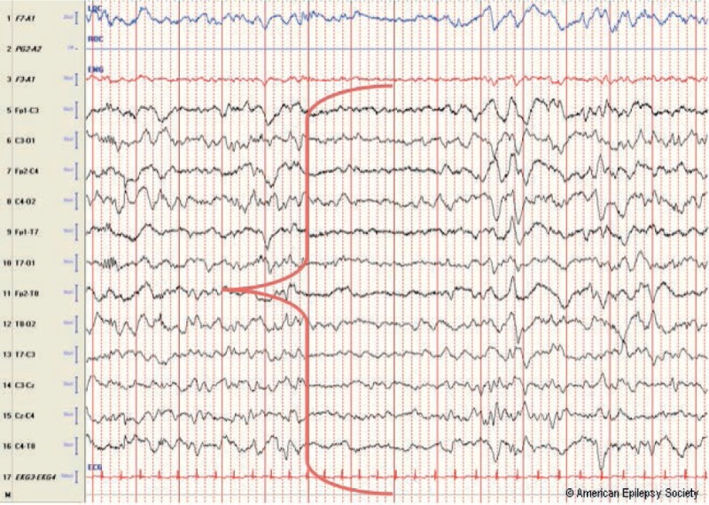
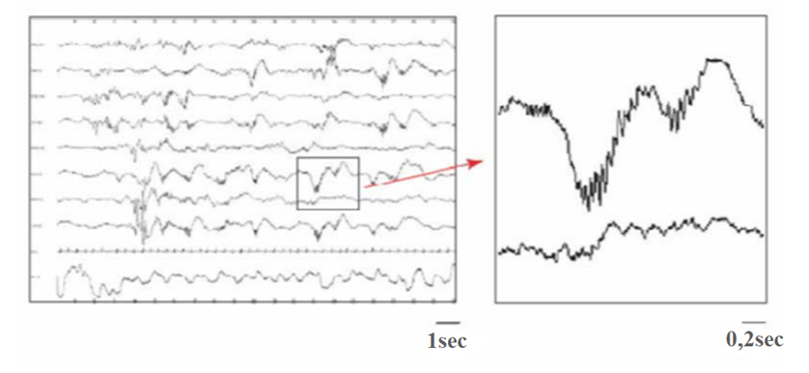
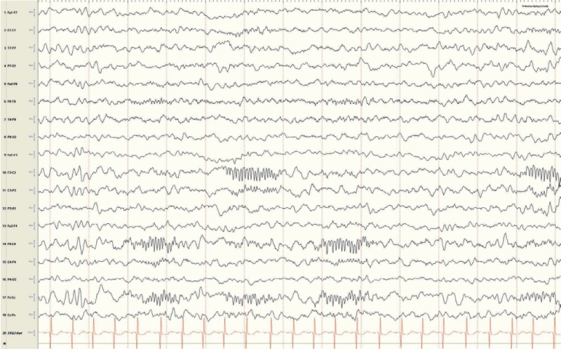
Continuous neonatal EEG
Tracé alternant
SS
Sleep spindles - highly synchronized oscillation (12-14 Hz) during up to 1 second
Delta-brush rhythm - “precursor” the of sleep spindles in older children
Notes:
Here are three neonatal EEG patterns and sleep spindles – the sleep phenomenon in both older children and adults, which will be described further.

Slide 9
First 3 Years of Life – What’s Happen with Sleep EEG
Many further maturational changes unfold during the first 3 years of life. This is critical period during which thalamocortical brain connections and gray matter of the cerebral cortex develop and mature.
Sleep spindles (SSs) first appear at 4-7 weeks in 50% and at 12 weeks in about 100% of babies. They have a particular morphology (a spiky negative component and a rounded positive component), are often asynchronous, short, low voltage (20 μV peak-to-peak) and infrequent (<3-4 per hour of quiet sleep). By 3 months of life, SSs increase in amplitude (up to 30–50 μV), duration and density (up to 4 per min. of quiet sleep). SSs between ages 8 to 12 months often have a “comb-like” shape. Fast spindles (13-14 Hz) are predominating until 12 month. Between 13 and 24 months, the activity of fast SSs decreases, they become more synchronous, their “sharpness” disappears.
V-waves and K-complexes develop between 3 and 6 months, and a slower frequency background of 1 to 3 Hz predominates during sleep. They configuration changes from blunt to sharp by 12 month of life;
REM sleep begins to diminish from approximately 50% levels of active (REM) sleep seen in newborns, to about 40% of sleep time by age 3 to 5 months, reaching 30% by 12 to 24 months of age.
Sokoloff G et al. Curr Biol. 2021
Notes:
Many further maturational changes unfold during the first 3 years of life. This is critical period during which thalamocortical brain connections and gray matter of the cerebral cortex develop and mature. Sleep spindles appear for the first time in early infancy. They have a particular morphology, often asynchronous, short, low voltage and infrequent. By 3 months of life, SSs increase in amplitude, duration and density. Fast spindles are predominate until 12 month. Between 13 and 24 months, the activity of fast SSs decreases, they become more synchronous, their “sharpness” disappears. K-complexes and vertex waves emerge later and have blunt configuration. Sharp vertex waves and K-complexes appear by 9-12 month of life.

Slide 10
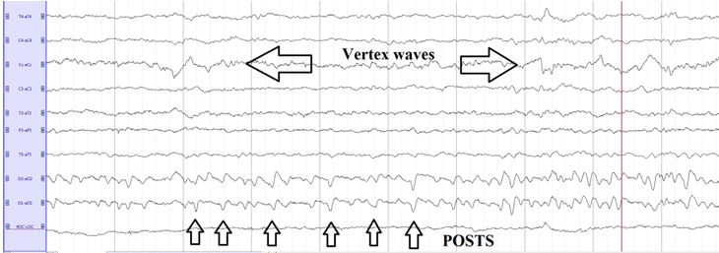
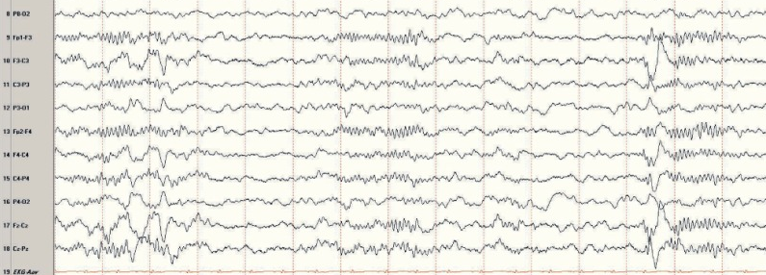
The Child is Maturing and Sleep EEG «Doing Too»
Between 3 and 5 years of age positive occipital sharp transients of sleep (POSTS) appear (NREM 1-2). They become more frequent from 6 to 12 years of age.
Common NREM sleep features including V-waves, K-complexes, and SSs become fully developed in school-aged children.
SS
K-complex
Sokoloff G et al. Curr Biol. 2021
Notes:
Between 3 and 5 years of age positive occipital sharp transients of sleep appear in the light NREM sleep. They become more frequent from 6 to 12 years of age. Common NREM sleep features including V-waves, K-complexes, and SSs become fully developed in school-aged children.

Slide 11
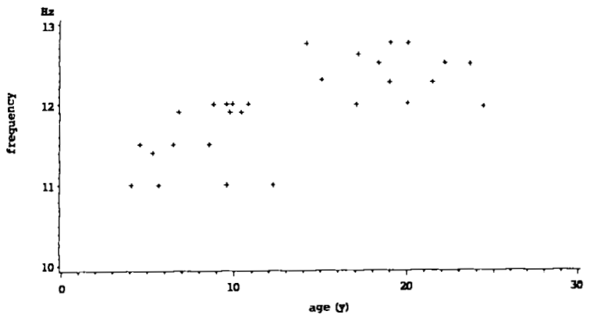
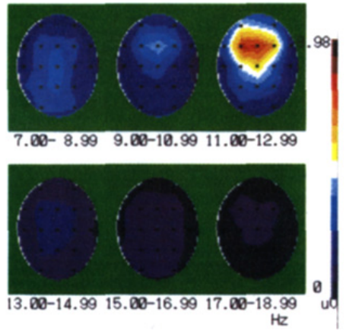
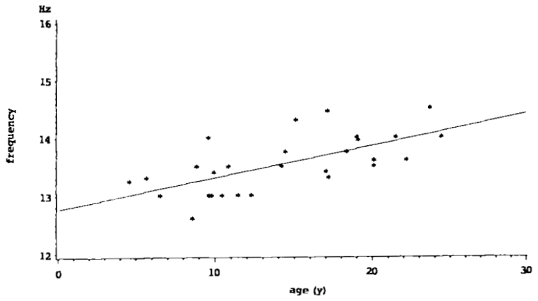
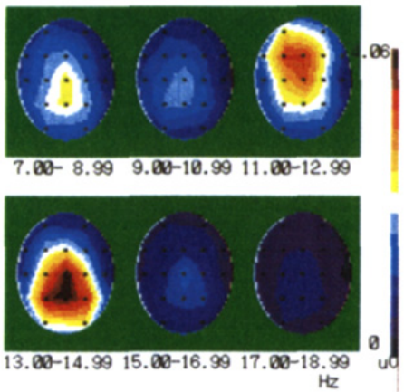
Sleep Spindles’ Maturation Trajectory Across Childhood
In younger children (3-6 years), frontal SSs are low-frequency (11-12 Hz) and more prominent than centroparietal SSs;
During the first decade of life, centrolparietal SSs are also in relatively low frequency range (12.5-13.5 Hz);
From early adolescence (about 13 years) the low-range centroparietal SSs (≤13.0 Hz) gradually disappear, and the frequency range is 13.5 - 14.5 Hz by 18 years. The frontal SSs shift from 11.0 - 12.0 Hz to 12.0 - 14 Hz;
From 4 to 16 years SSs density progressively increases, than gradually decrease.
Peak frequency of frontal SSs is in the range of 11-12 Hz during the first decade and
changes in early adolescence to the range of 12-14 Hz
Peak frequency of centroparietal SSs
becomes higher linearly with increasing age
LeBourgeois MK et al. Neuroimage. 2019
Notes:
There is sleep spindles’ maturation trajectory across childhood. During the first decade of life, frontal spindles are low-frequency and more prominent than centroparietal. From early adolescence the low-range frontal and centroparietal spindles gradually disappear, and the frequency become higher by 18 years of life.

Slide 12
Conclusions
In ontogenesis, dynamic changes in the characteristics of a child’s sleep are noted, which must be taken into account for the correct interpretation of clinical data and optimization of its development and learning;
Simultaneous changes in sleep EEG and cerebral cortex areas across childhood may indicate the presence of certain causal relationships, which is a “window of opportunity” for diagnosing and predicting the adequate maturation of the higher cortical functions and/or its disorders;
Understanding the features of sleep EEG pattern development from birth to adolescence can facilitate the search for their cognitive-behavioral correlates and become the basis for further fundamental studies of the neurophysiological mechanisms of postnatal brain maturation and neuroplasticity.
Notes:
And so, the conclusion. In ontogenesis, dynamic changes in the characteristics of a child’s sleep are noted, which must be taken into account for the correct interpretation of clinical data and optimization of its development and learning. Simultaneous changes in sleep EEG and cerebral cortex areas across childhood may indicate the presence of certain causal relationships, which is a “window of opportunity” for diagnosing and predicting the adequate maturation of the higher cortical functions and/or its disorders. And finally, understanding the features of sleep EEG pattern development from birth to adolescence can facilitate the search for their cognitive-behavioral correlates and become the basis for further fundamental studies of the neurophysiological mechanisms of postnatal brain maturation and neuroplasticity.

Slide 13
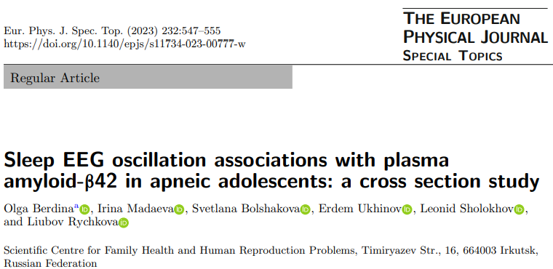
Our Pilot Results:
SWA
SS number
SS density
102 high school male students
4 study groups
Full-night PSG recording
Sleep stage and spindle detection
SS amplitude
SA+OB
SS duration
SA
SS frequency
OB
Controls
min
max
Notes:
And now let me present the results of our pilot project to study the features sleep spindles’ pattern in high school students with somatic diseases, such as sleep apnea and obesity. There were found significant differences between time spent in slow wave sleep. Both number and density of sleep spindles progressively declined, and their amplitude and frequency significantly increased from the apneic groups to the control group. Differences were statistically significant between both apneic groups and control groups; no statistically significant differences were observed between the apneic groups with no and obesity. We have shown that adolescents with sleep apnea, especially with co-obesity, have the most alterations sleep pattern than participants in other study groups. We concluded that altered slow wave and spindles activity during sleep in sleep apnea may represent an early dysfunction, possibly reflecting brain damage through hypoxia and metabolic stress.

Slide 14

HAVE A QUALITY SLEEP AND WONDERFUL LIFE!
THANKS FOR YOUR ATTENTION!

